Slide 1
A Statistical Data Mining Approach to Determining the Factors that Distinguish Championship Caliber Teams in the NFL
Authors: Ernest Fokoué & Dan Foehrenbach
Source: RIT Scholar Works
Presented by: Rishi Bhuptani, Arul Palaniappan, Peiwei Xiao, & Chelton Kuang

Slide 2
Source
Rochester Institute of Technology Scholar Works
Archive for RIT’s faculty, staff, and students’ research
Paper presented at the 2011 Joint Statistical Meetings
Annual conference held by the American Statistical Association
Largest community of statisticians in the world
Prestigious event in the statistician community

Slide 3
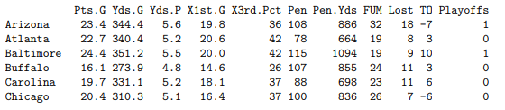
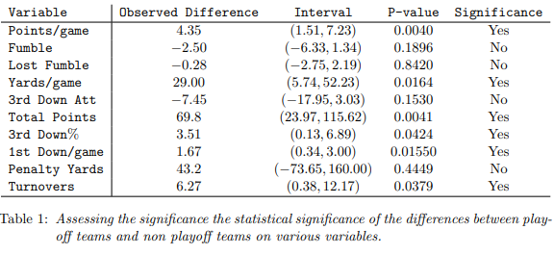
Summary of the Study
Find the difference between good and bad NFL teams
Criteria: whether they reached the playoffs or not
Features were split into:
Offense - Points per game, yards per game, etc.
Defense - Fumbles, turnovers, etc.
T-test comparison to find significant variables
Points per game, yards per game
Remove highly redundant variables

Slide 4
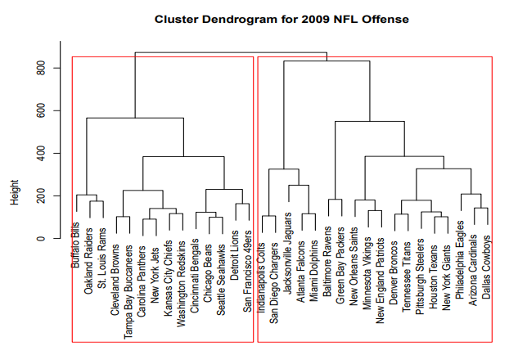
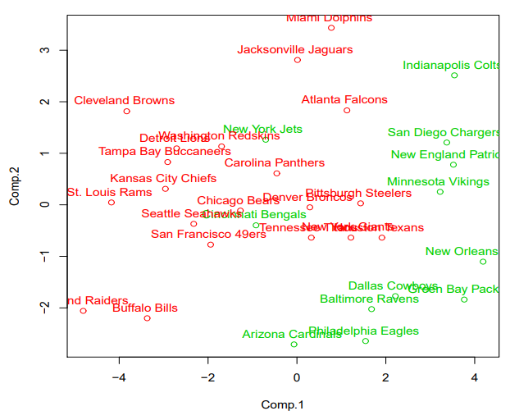
Results
Show boundary between good and bad teams
Cluster dendrogram
PCA-reduced two-dimensional plot
Two “good” teams should actually be classified as bad teams

Slide 5
Key Learnings
More comprehensive analysis:
Offense and defense should also be considered together
Special teams could be another factor that makes a good team
Looking features separately & objectively - identify features that have high impact
Some factors may be dependent - we would need to determine and separate
Used only one season’s worth of data
Using data from 2010 to 2020 seasons should allow for relatively solid predictions in the 2021 season

Slide 6
Relevance to Course
Dataset has n=32 team observations where each row of NFL team has p=13 dimensions
Paper implies an unsupervised clustering technique
Hierarchical clustering predicts the 14 teams as the playoff teams by similarity
Plotting the first two principal components show that Cincinnati and New York are separated from the playoff set

Slide 7
Relevance to Project
Authors figured out the relevant statistics to apply to their model using p-values and manual feature selection
Our daily fantasy data set has various statistics of each player from their game logs
We used manual feature selection in our project in order to keep the most important features to use in our daily fantasy data set
We also added features not in normal player datasets such as rest days, injuries, and opposing teams to improve the models.

Slide 8
Thank You for Listening!

